Slide 1
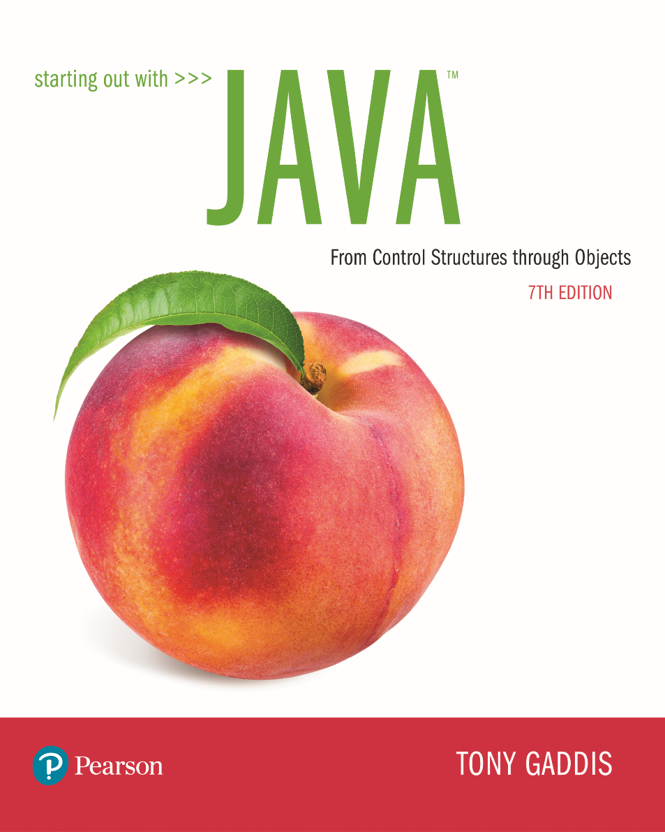

Slide 2
Examples’ Source Code
Source Code for examples presented in these slides can be found on:
Blackboard->Course Content->Source Code Of The Book Examples

Slide 3
Module 2 Topics
Module 2 discusses the following main topics:
3.1 The if Statement 3.2 The if-else Statement 3.3 Nested if Statements 3.4 The if-else-if Statement 3.5 Logical Operators 3.6 Comparing String Objects 3.7 More about Variable Declaration and Scope
3.8 The Conditional Operator (Optional)
3.9 The switch Statement

Slide 4
The if Statement
The if statement decides whether a section of code executes or not.
The if statement uses a boolean to decide whether the next statement or block of statements executes.
if (boolean expression is true)
execute next statement.

Slide 5
The if, if else Statements
if (expression)
statementOrBlockIfTrue;
if (expression)
statementOrBlockIfTrue;
else
statementOrBlockIfFalse;

Slide 6
Flowcharts
If statements can be modeled as a flow chart.
if (coldOutside)
wearCoat();
Is it cold
outside?
Yes
Wear a coat.

Slide 7
Flowcharts
A block if statement may be modeled as:
if (coldOutside) {
wearCoat();
wearHat();
wearGloves();
}
Is it cold
outside?
Yes
Wear a coat.
Wear a hat.
Wear gloves.
Note the use of curly
braces to block several
statements together.

Slide 8
Relational Operators
In most cases, the boolean expression, used by the if statement, uses relational operators.
Relational Operator | Meaning
> | is greater than
< | is less than
>= | is greater than or equal to
<= | is less than or equal to
== | is equal to
!= | is not equal to

Slide 9
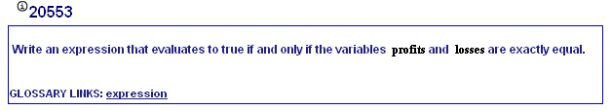
My Programming Lab 2 – 3.1 Relational Operators

Slide 10
Boolean Expressions
A boolean expression is any variable or calculation that results in a true or false condition.
Expression | Meaning
x > y | Is x greater than y?
x < y | Is x less than y?
x >= y | Is x greater than or equal to y?
x <= y | Is x less than or equal to y.
x == y | Is x equal to y?
x != y | Is x not equal to y?

Slide 11
if Statements and Boolean Expressions
if (x > y)
System.out.println("X is greater than Y");
if(x == y)
System.out.println("X is equal to Y");
if(x != y)
{
System.out.println("X is not equal to Y");
x = y;
System.out.println("However, now it is.");
}
Example: AverageScore.java

Slide 12
Programming Style and if Statements
An if statement can span more than one line; however, it is still one statement.
if (average > 95)
grade = ′A′;
is functionally equivalent to
if(average > 95) grade = ′A′;

Slide 13
Programming Style and if Statements
No semicolon here. Semicolon ends statement here.
Rules of thumb:
The conditionally executed statement should be on the line after the if condition.
The conditionally executed statement should be indented one level from the if condition.
If an if statement does not have the block curly braces, it is ended by the first semicolon encountered after the if condition.
if (expression)
statement;

Slide 14
Block if Statements
Conditionally executed statements can be grouped into a block by using curly braces {} to enclose them.
If curly braces are used to group conditionally executed statements, the if statement is ended by the closing curly brace.
if (expression)
{
statement1;
statement2;
}
Curly brace ends the statement.

Slide 15
Block if Statements
Remember that when the curly braces are not used, then only the next statement after the if condition will be executed conditionally.
if (expression)
statement1;
statement2;
statement3;
Only this statement is conditionally executed.

Slide 16
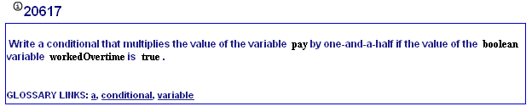
My Programming Lab 2 – 3.1 if-statement

Slide 17
Flags
A flag is a boolean variable that monitors some condition in a program.
Flags are used when there are a range of values that are being tested for
When a condition is true, the flag is set to true.
The flag can be tested to see if the condition has changed.
if (average > 95)
highScore = true;
Later, this condition can be tested:
if (highScore)
System.out.println("That′s a high score!");

Slide 18
Comparing Characters
Characters can be tested with relational operators.
Characters are stored in memory using the Unicode character format.
Unicode is stored as a sixteen (16) bit number (2 bytes).
Characters are ordinal, meaning they have an order in the Unicode character set.
Since characters are ordinal, they can be compared to each other (can use relational operators).
char c = ′A′;
if(c < ′Z′)
System.out.println("A is less than Z");

Slide 19
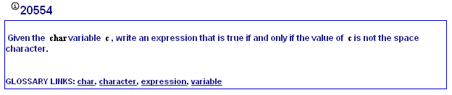
My Programming Lab 2 – 3.2 character compare

Slide 20
if-else Statements
The if-else statement adds the ability to conditionally execute code when the if condition is false.
if (expression)
statementOrBlockIfTrue;
else
statementOrBlockIfFalse;

Slide 21
if-else Statement Flowcharts
No
Yes
Is it cold
outside?
Wear shorts.
Wear a coat.

Slide 22
Nested if Statements
If an if statement appears inside another if statement (single or block) it is called a nested if statement.
The nested if is executed only if the outer if statement results in a true condition.
See example: LoanQualifier.java

Slide 23
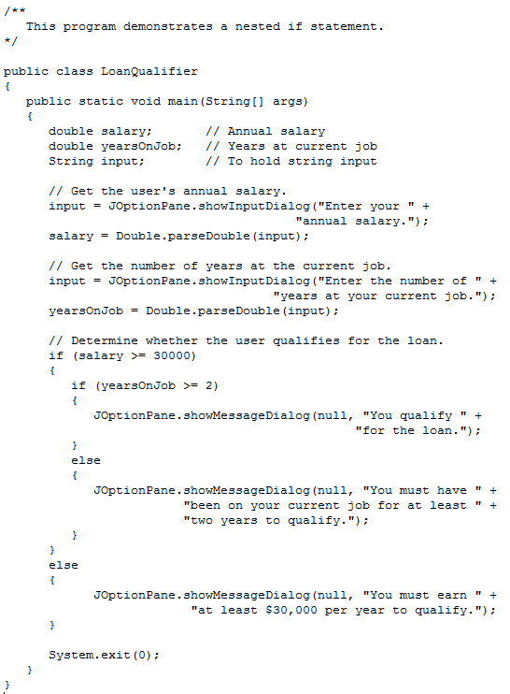

Slide 24
Nested if Statement Flowcharts
No
Yes
Is it cold
outside?
Wear shorts.
No
Is it
snowing?
Yes
Wear a jacket.
Wear a parka.

Slide 25
Nested if Statements
if (coldOutside)
{
if (snowing)
{
wearParka();
}
else
{
wearJacket();
}
}
else
{
wearShorts();
}

Slide 26
if-else Matching
Curly brace use is not required if there is only one statement to be conditionally executed.
However, sometimes curly braces can help make the program more readable.
Additionally, proper indentation makes it much easier to match up else statements with their corresponding if statement.

Slide 27
Alignment and Nested if Statements
if (coldOutside)
{
if (snowing)
{
wearParka();
}
else
{
wearJacket();
}
}
else
{
wearShorts();
}
This if and else
go together.
This if and else
go together.

Slide 28
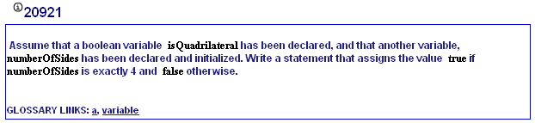
My Programming Lab 2 – 3.1 Boolean

Slide 29
if-else-if Statements
comparing a small finite number of possibilities
if (expression_1)
{
statement;
statement;
etc.
}
else if (expression_2)
{
statement;
statement;
etc.
}
Insert as many else if clauses as necessary
else
{
statement;
statement;
etc.
}
If expression_1 is true these statements are executed, and the rest of the structure is ignored.
Otherwise, if expression_2 is true these statements are executed, and the rest of the structure is ignored.
These statements are executed if none of the expressions above are true.

Slide 30
if-else-if Statements
Nested if statements can become very complex.
The if-else-if statement makes certain types of nested decision logic simpler to write.
Care must be used since else statements match up with the immediately preceding unmatched if statement.
See example: TestResults.java

Slide 31
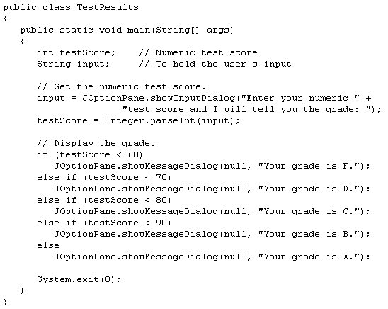

Slide 32
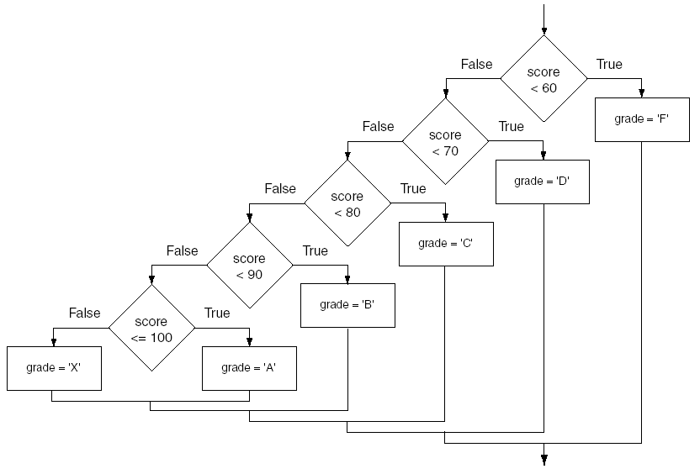
if-else-if Flowchart

Slide 33
Logical Operators
Java provides two binary logical operators (&& and ||) that are used to combine boolean expressions.
Java also provides one unary (!) logical operator to reverse the truth of a boolean expression.

Slide 34
Logical Operators
Operator | Meaning | Effect
&& | AND | Connects two boolean expressions into one. Both expressions must be true for the overall expression to be true.
|| | OR | Connects two boolean expressions into one. One or both expressions must be true for the overall expression to be true. It is only necessary for one to be true, and it does not matter which one.
! | NOT | The ! operator reverses the truth of a boolean expression. If it is applied to an expression that is true, the operator returns false. If it is applied to an expression that is false, the operator returns true.

Slide 35
The && Operator
The logical AND operator (&&) takes two operands that must both be boolean expressions.
The resulting combined expression is true if (and only if) both operands are true.
Expression 1 | Expression 2 | Expression1 && Expression2
true | false | false
false | true | false
false | false | false
true | true | true

Slide 36
The || Operator
The logical OR operator (||) takes two operands that must both be boolean expressions.
The resulting combined expression is false if (and only if) both operands are false.
Expression 1 | Expression 2 | Expression1 || Expression2
true | false | true
false | true | true
false | false | false
true | true | true

Slide 37
The ! Operator
The ! operator performs a logical NOT operation.
If an expression is true, !expression will be false.
if (!(temperature > 100))
System.out.println("Below the maximum temperature.");
If temperature > 100 evaluates to false, then the output statement will be run.
Expression 1 | !Expression1
true | false
false | true

Slide 38
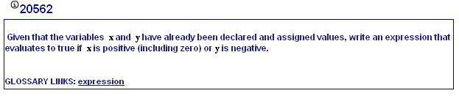
My Programming Lab 2 – 3.5

Slide 39
Short Circuiting
Logical AND and logical OR operations perform short-circuit evaluation of expressions.
Logical AND will evaluate to false as soon as it sees that one of its operands is a false expression.
Logical OR will evaluate to true as soon as it sees that one of its operands is a true expression.
if((x > y) && (y < z))
if((x>y)||(y<z))

Slide 40
Order of Precedence
The ! operator has a higher order of precedence than the && and || operators.
The && and || operators have a lower precedence than relational operators like < and >.
Parenthesis can be used to force the precedence to be changed.

Slide 41
Order of Precedence
Order of Precedence | Operators | Description
1 | (unary negation) ! | Unary negation, logical NOT
2 | * / % | Multiplication, Division, Modulus
3 | + - | Addition, Subtraction
4 | < > <= >= | Less-than, Greater-than, Less-than or equal to, Greater-than or equal to
5 | == != | Is equal to, Is not equal to
6 | && | Logical AND
7 | || | Logical OR
8 | = += -= *= /= %= | Assignment and combined assignment operators.

Slide 42
Comparing String Objects
In most cases, you cannot use the relational operators to compare two String objects.
Reference variables contain the address of the object they represent.
Unless the references point to the same object, the relational operators will not return true.
See example: StringCompare.java
See example: StringCompareTo.java

Slide 43
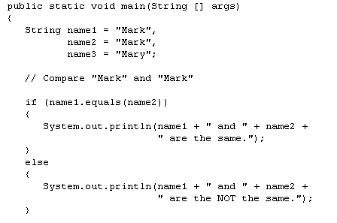
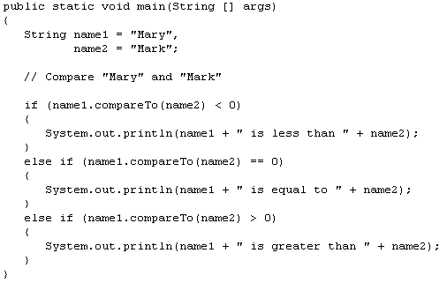
if(name1 == name2)
if(name1 > name2)

Slide 44
Ignoring Case in String Comparisons
In the String class the equals and compareTo methods are case sensitive.
In order to compare two String objects that might have different case, use:
equalsIgnoreCase, or
compareToIgnoreCase
See example: SecretWord.java

Slide 45
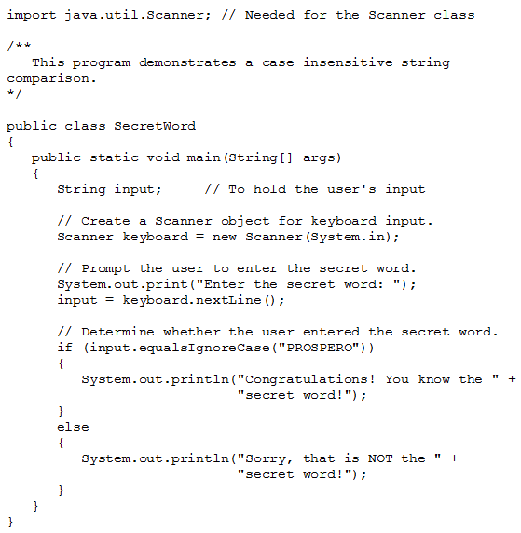

Slide 46
Variable Scope
In Java, a local variable does not have to be declared at the beginning of the method.
The scope of a local variable begins at the point it is declared and terminates at the end of the method.
When a program enters a section of code where a variable has scope, that variable has come into scope, which means the variable is visible to the program.
See example: VariableScope.java

Slide 47
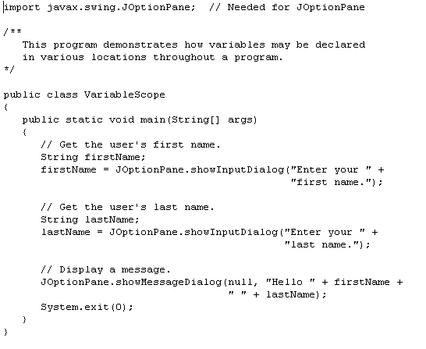
local variable begins at the point it is declared and terminates at the end of the method

Slide 48
The Conditional Operator
The conditional operator is a ternary (three operand) operator.
You can use the conditional operator to write a simple statement that works like an if-else statement.
BooleanExpression ? Value1 : Value2

Slide 49
The Conditional Operator
Example:
z = x > y ? 10 : 5;
This line is functionally equivalent to:
if(x > y)
z = 10;
else
z = 5;

Slide 50
The Conditional Operator
Many times the conditional operator is used to supply a value.
number = x > y ? 10 : 5;
This is functionally equivalent to:
if(x > y)
number = 10;
else
number = 5;

Slide 51
The switch Statement
The if-else statement allows you to make true / false branches.
The switch statement allows you to use an ordinal value to determine how a program will branch.
The switch statement can evaluate an integer type or character type variable and make decisions based on the value.

Slide 52
The switch Statement
The switch statement takes the form:
switch (SwitchExpression)
{
case CaseExpression:
// place one or more statements here
break;
case CaseExpression:
// place one or more statements here
break;
// case statements may be repeated
//as many times as necessary
default:
// place one or more statements here
}

Slide 53
The switch Statement
switch (SwitchExpression)
{
…
}
The switch statement will evaluate the SwitchExpression, which can be a byte, short, int, long, or char. If you are using Java 7, the SwitchExpression can also be a string.
If there is an associated case statement that matches that value, program execution will be transferred to that case statement.

Slide 54
The switch Statement
Each case statement will have a corresponding CaseExpression that must be unique.
case CaseExpression:
// place one or more statements here
break;
If the SwitchExpression matches the CaseExpression, the Java statements between the colon and the break statement will be executed.

Slide 55
The case Statement
The break statement ends the case statement.
The break statement is optional.
If a case does not contain a break, then program execution continues into the next case.
See example: NoBreaks.java
See example: PetFood.java
The default section is optional and will be executed if no CaseExpression matches the SwitchExpression.
See example: SwitchDemo.java

Slide 56
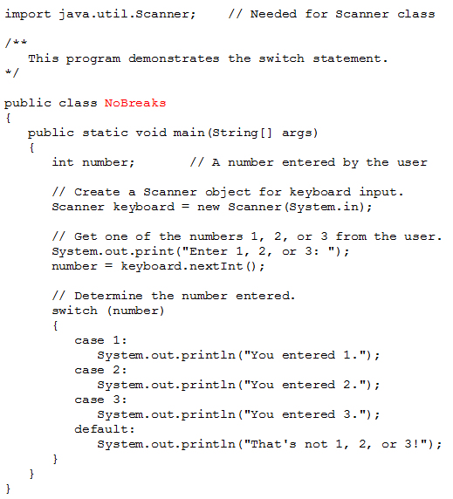

Slide 57
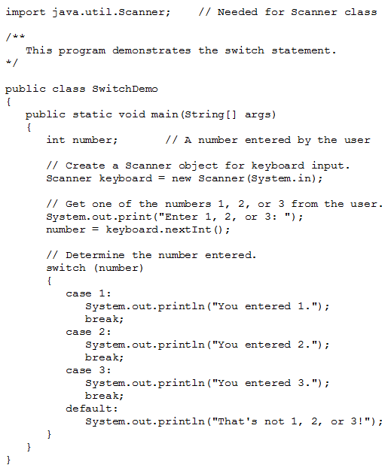

Slide 58
